Slide 1
Selenium
By Smita B Kumar

Slide 2
Day2 Module 7: Selenium Framework Creation and Accessing Test Data from Excel
Framework Creation and Accessing test data from the excels Framework creation strategy Sample project

Slide 3
Framework Creation and Accessing test data from the excels
Let’s get acquainted with a sample framework, the Excels which would store the test data and their Excel manipulations. On the same lines, we would move forward and introduce new strategies and resources to mature our framework.
So let’s learn:
Framework creation strategy using a sample project.
Access the test data stored in the external data source.
Moving ahead, we would start with the description of the project hierarchy that we would be creating in order to segregate the various project components.

Slide 4
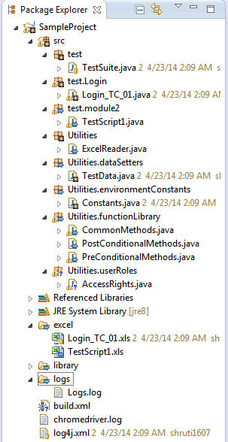
Framework Creation and Accessing test data from the excels
Refer the below image for the project hierarchy created for the sample project. The below java project can be easily created within the eclipse the way we have created the projects in the earlier modules.

Slide 5
Selenium Project Folder Structure – Walkthrough
#1) src – The folder contains all the test scripts, generics, readers and utilities. All these resources are nothing but the simple java classes. Under the source (src) folder, we have created a hierarchy of folders.
a) test – The “test” folder is constituted of majorly two ingredients – testsuite and the folders representing the various modules of the application under test. Thus, each of these folders contains the test scripts specific to the module to which it is associated. Testsuite is a logical combination of more than one test scripts. Thus, the user can mark an entry of any of the test script within the testsuite that he/she desires to execute in the subsequent runs.
b) utilities – The “utilities” folder is constituted of various generics, constants, Readers and classes for implementing user defined exceptions. Each of the folders under utilities has got its own significance.
Excel Reader – A generic and common class has been created to read the test data (input parameters and expected results) from the Excel sheets
EnvironmentConstants – The folder are integration of the java classes that stores the static variables referencing to the paths and other environmental details. These details can be Application URL, URL to the Databases, Credentials for Databases, and URL to any third party tool being used. The disparate application URLs can be set for different environments (dev, prod, test, master, slave etc).

Slide 6
Selenium Project Folder Structure – Walkthrough
DataSetters – The folder incorporates the classes that implement the getters and setters of the test data fetched from the Excels. To lode multiple sets of Test data, we create ArrayLists.
UserRoles – The folder accommodates the classes that take care of the Role based access criteria if any for instinct users.
FunctionLibrary – The folder is constituted of the classes which contain functions and methods that can be shared and used amongst the multiple classes. Very often, we are suppose to perform certain procedures prior and aftermath to the actual test execution like login to the application, setting up environments, activities related to rolls, data manipulations, writing results, methods those generate pre/post-conditions to other methods. Since we tend to perform these activities for all or most of the test script. Thus it is always recommended to create a separate class for such activities instead of coding them repeatedly in each of the test script.
PreConditionalMethods
PostConditionalMethods

Slide 7
Selenium Project Folder Structure – Walkthrough
Very often, we are suppose to perform certain procedures prior and aftermath to the actual test execution like login to the application, setting up environments, activities related to user rolls, data manipulations, writing results, methods those generate pre/post-conditions to other methods. Since we tend to perform these activities for all or most of the test script, thus it is always recommended to create a separate class for such activities instead of coding them repeatedly in each of the test script.
CommonMethods
Like Pre and post conditions, there may be methods and functions those can be used by more than one test script. Thus, these methods are grouped together in a class. The testscript can access these methods using the object of the common class.

Slide 8
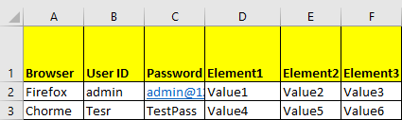
Selenium Project Folder Structure – Walkthrough
#2) excelFiles – The excel files are considered to be the data source/data providers for test script execution. These files store the test data into key value pairs. Make a note that we create a separate excel sheet for each of the test script i.e. each test script has its own test data file. The name of the test script and the corresponding test data files/ excel sheet has been kept same for the traceability perspective. Check out the sample test data format below:
Test Data Format
Each of the columns represents a key and each of the rows represents a test data/value. Specify the multiple rows in order to execute the same test script with multiple data sets.
Mark that the test data formats are solely user defined. Thus based on your requirements, you can customize the test data files.

Slide 9
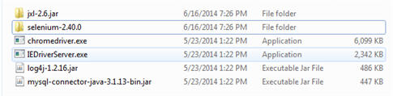
Selenium Project Folder Structure – Walkthrough
#3) library – The folder acts as a repository/artifactory for all the required jar files, libraries, drivers etc to successfully build the test environment and to execute the test scripts. Refer the following figure to check out the libraries we would be employing within our project.

Slide 10
Selenium Project Folder Structure – Walkthrough
#4) logs – The folder contains a .txt file that stores the logging information upon each execution.
#5) testMaterial – The folder contains the actual test data that needs to be uploaded if any. This folder would come into picture when we come across test scenarios where the user is required to upload files, documents, pictures, reports etc.
#6) build.xml – The xml file is used by the “Ant Server” to automate the entire build process.
#7) log4j.xml – This xml file is used by a Java based utility named as “Log4j” to generate the execution logs.
Note: We would study more about the logs, user defined exceptions and Ant in detail in the upcoming modules. So don’t panic if you get confused between the notions.

Slide 11
Test Data Creation
Now, as we move forward let us understand the phenomenon where we access the excel files and populate the test data into our test scripts.
In order to comprehend the process easily, we would break down the process into the following steps.

Slide 12
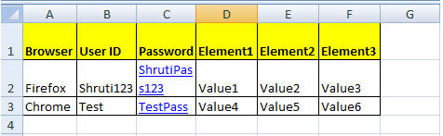
Test Data Creation
Step 1: The first and the foremost step is to create the test data with which we would be executing the test scripts. Considering the aforementioned test data format, let us create an excel file named as “TestScript1”. Furnish the values in the elements.
Step 2: The next step is to download a standard java based API/Library named as “Java excel Library” (jxl) to be able to access the already created generic methods for Excel Manipulation.

Slide 13
Test Data Creation
Step 3: Create a generic excel reader class named as “ExcelReader.java”. Copy the below code in the ExcelReader.java.
Step 4: Create a generic class –“CommonMethods.java”. Create a common method within the class that would read the cells from the excel sheet using the methods implemented in ExcelReader.java.
Step 5: Create a new java class named as “TestData.java”. This class would act as a getter and setter for excel data. Copy and paste the following code in the TestData.java class.
Step 6: The next step is to create instances of “TestData.java” and “CommonMethods.java” java classes within the test script in order to access and populate the test data. Refer the below code snippet for object initialization, reading excel data and populating the values wherever required.

Slide 14
Conclusion
Therefore using the instance of testData.java class in conjunction with getters, any test data value can be populated within the script.
Conclusion:
The module mainly revolved around the notions like Framework Creation and Accessing test data from the excels. We made you acquainted with the Framework creation strategy using a sample project. We briefly laid light on the various components and aspects of our framework.
In order to access the test data stored in the external data source, we used a java based API – jxl. We also created the sample code for reading and populating the excel data into the testscripts.

